Slide 1
One World
Day 3 – Reducing Water Waste
June 2022
Proud history, bright future.

Slide 2
Only One Earth – Reduction of water Waste
Water is a precious resource – and it can’t be taken for granted. Climate change, and the more extreme weather that comes with it, means that water supply is becoming unpredictable as draughts become increasingly common, especially in summer months.
In the UK, the average household currently uses around 330 litres of water a day – that’s approximately 140 litres per head, every day. According to waterwise, 85% of people don’t know how much they use per day on average. If they make a guess, they generally estimate between 50 and 100 litres per day – well below the actual figure.
If you want to get to grips with water consumption in your home, energy savings trust have put together the following quick and easy ways to reduce the amount of water you use every day.
What will you do to reduce your water usage?
For more information go to: www.energysavingtrust.org.uk

Slide 3
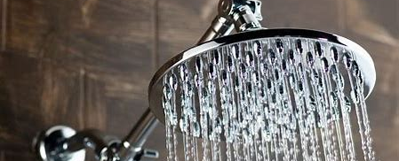
Snub the tub in favour of the shower
If everybody in a family of four replaces one bath a week with a five-minute shower, up to £10 a year could be saved on gas bills and up to £10 on water bills (if you have a water meter).
*Replacing your shower head with a water efficient one could save a four-person household as much as £38 a year on gas for water heating, as well as a further £53 a year on water bills if they have a water meter.
Spending one minute less in the shower each day will up to £8 a year off your energy bills, per person With a water meter this could save a further £11 of annual water and sewage bills

Slide 4
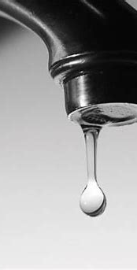
Other Bathroom Savings
A running tap wastes more than 5 litres of water a minute, so turn off the tap while brushing your teeth, shaving, or washing your face. Use cold water if you don’t need hot.
A dripping tap can waste more than 5,300 litres of water a year, so make sure your taps are properly turned off and change washers promptly when taps start to drip.
If your loo is not the latest model and not water efficient you can recycle a plastic bottle, fill it will water and place it into the toilet cistern. This reduces the amount of water you use each time you flush.

Slide 5
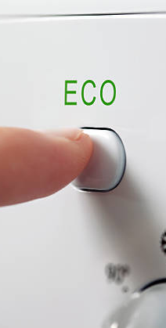
Kitchen Water Savings
Using a bowl to wash up rather than a running tap can save you money on your energy and water bills if you have a water meter. In fact, you only need to run a typical tap for 95 seconds to fill a washing up bowl
Make sure that dishwashers and washing machines are full before you use them, and ensure you always use the most efficient water and energy settings. Wash at 30 degrees or use the eco setting if your machine has one.
When making coffee or tea, only fill the kettle with the amount of water you need, You’ll not only save water, but you could also cut around £6 a year off your energy bill.

Slide 6

The detail and more information
* Calculation is based on replacing a 9.82 litre/minute shower head with a 7.7 litre/minute efficient shower head. Water efficient shower heads are incompatible with electric showers.
For more information about reduction of water waste and other energy sources go to:
www.energysavingtrust.org.uk

