Slide 1
One World
Living in Harmony with Nature
June 2022
Proud history, bright future.

Slide 2
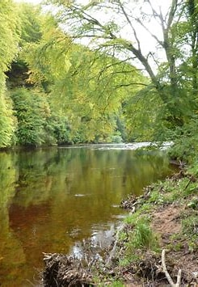
Wildlife Trust
There is loads of information on the wildlife trust website detailing how you can help many species that are in decline in the UK.
There is information that will suit every garden
You can become a member of your wildlife trust. You will be helping to look after the wildlife and wild places in your area. There are 46 Wildlife Trusts covering the whole of the UK. Each is an independent charity working to make a positive difference to the natural world. Every Wildlife Trust has different membership fees, most start at around £3 a month.
For more information about the work, they do and joining go to:
www.wildlifetrust.org

Slide 3
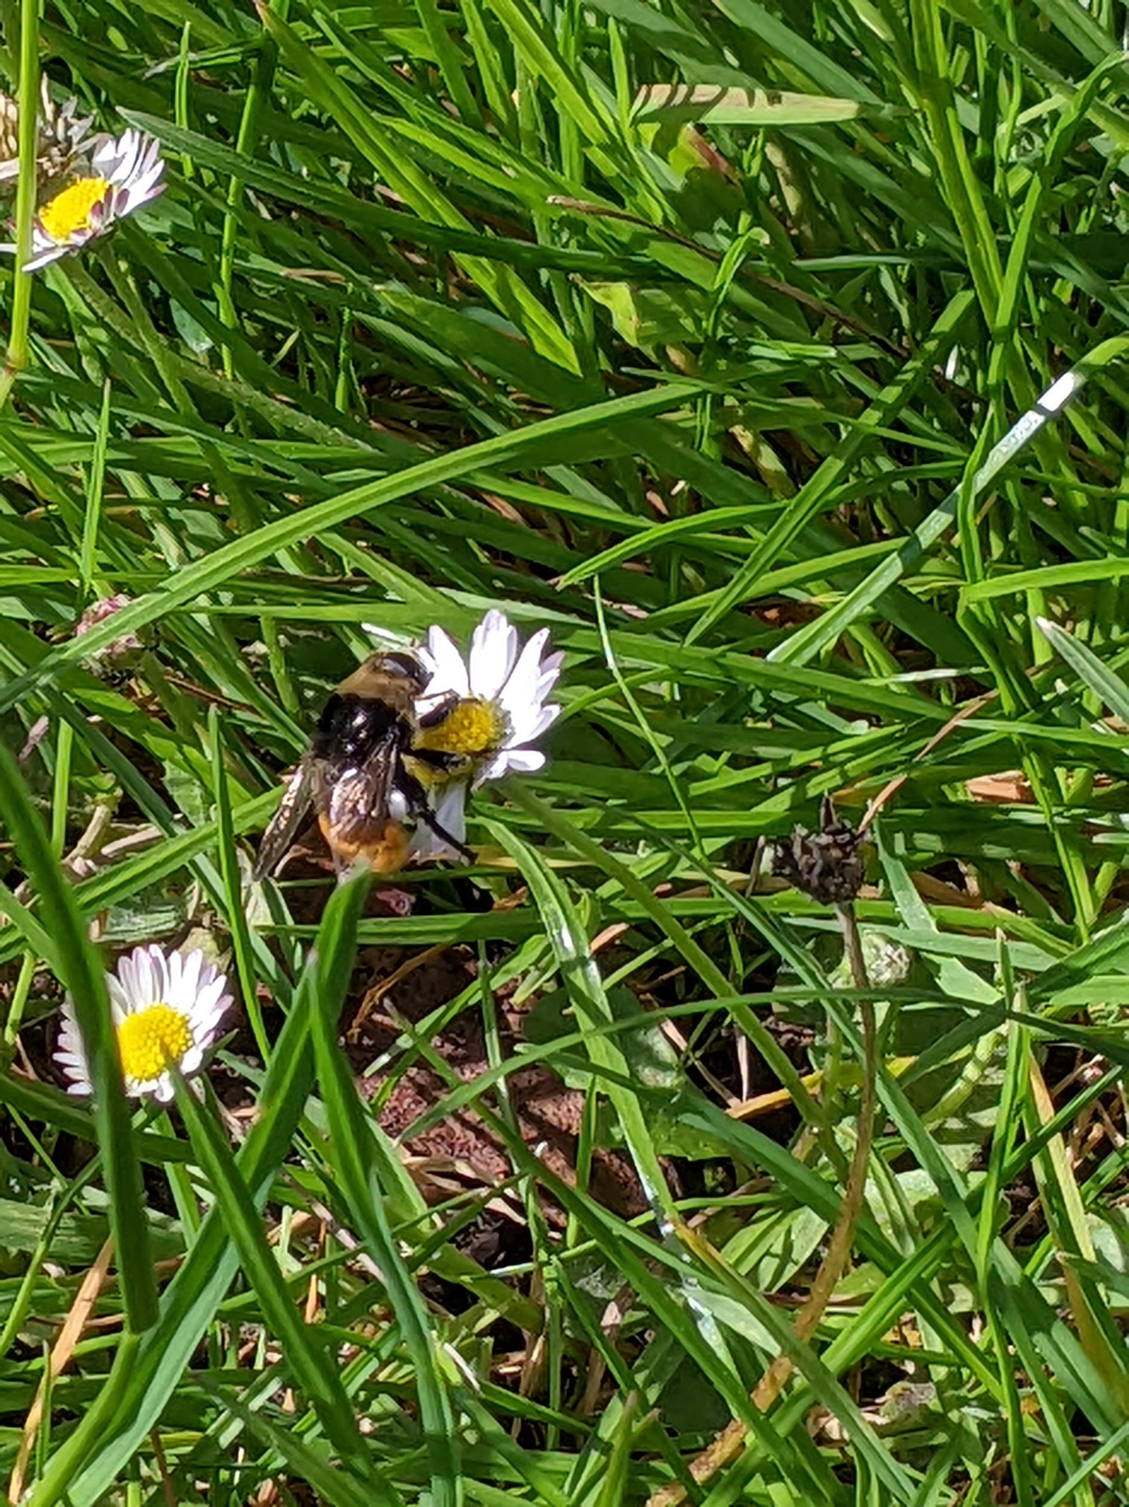
Looking after Pollinators (Bees and Butterflies)
Bumblebees are vitally important for pollinating hundreds of plant species, including many crops. But they are under threat from the loss and degradation of their habitats due to pressures such as development, agriculture intensification and climate change.
Bumblebees look for certain types of flowers. Those with shorter tongues need short, open flowers, with nectar within easy reach. This includes flowers from the daisy family and alliums, which have several small flowers on one stalk. Bumblebees with long tongues can enjoy deeper flowers like honey suckle.
Having some early and some late flowers in your planting mix will prolong the nectar season for bumblebees

Slide 4
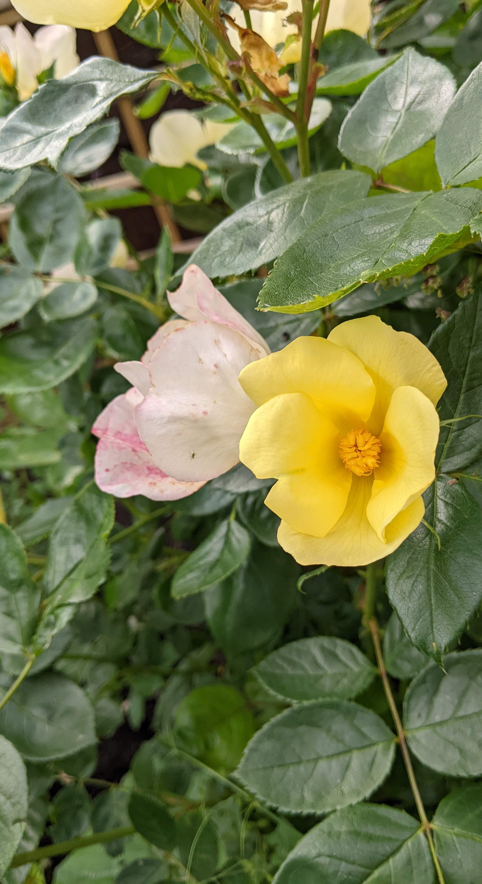
Best Plants for Pollinators
Provide for bees and butterflies all year round by planting shrubs and plants that flower at different times.
Spring Plants include
  Primrose
  Garlic Mustard
  Sweet rocket
  Aubretia
  Honesty
Summer plants include
  Honeysuckle
  Lavender
  Red Valarian
  Hebe
  Yarrow
Autumn plants include
  Ivy
  Hyssop
  Ice Plant
  Sweet Scabious
  Michaelmas daisy
There is more information available at:
www.Hiwwt.org.uk or www.wildlifewatch.org.uk

Slide 5
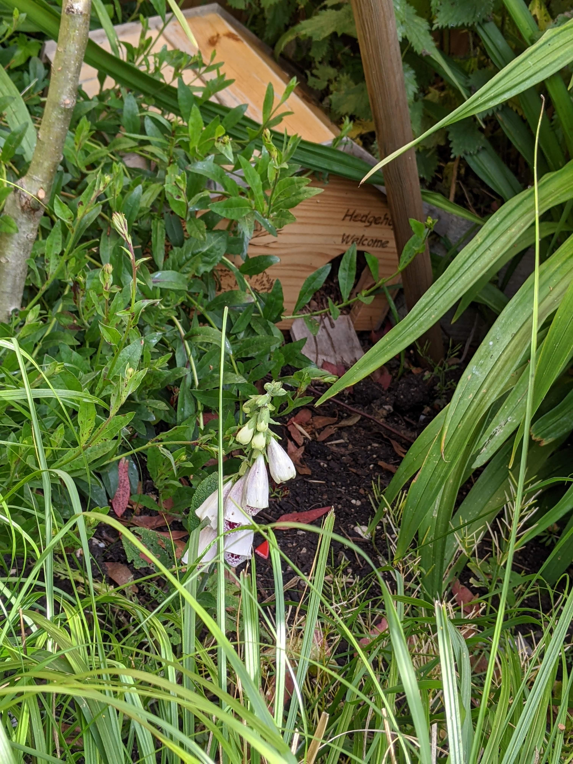
Hedgehogs
Sadly, the number of hedgehogs in the UK has plummeted over recent years. While there were estimated to be around 1.5 million in 1995 there is believed to be less than 500,000 today.
Hedgehogs need homes just like humans, so making one for them is a great way to encourage them into your garden. Hedgehogs are becoming increasingly reliant on urban and suburban gardens. Urban populations of hedgehogs have increased by up to a third, while rural populations have halved. This decline is likely caused by loss or degradation of our habitats due to pressures such as development agricultural intensification and climate change.
So, whether you live in town or country, you can help to look after garden wildlife like hedgehogs by providing food, water and shelter.
For more information on allowing Hedgehogs access to your garden, building a shelter and providing food go to:
www.hiwwt.org.uk

Slide 6
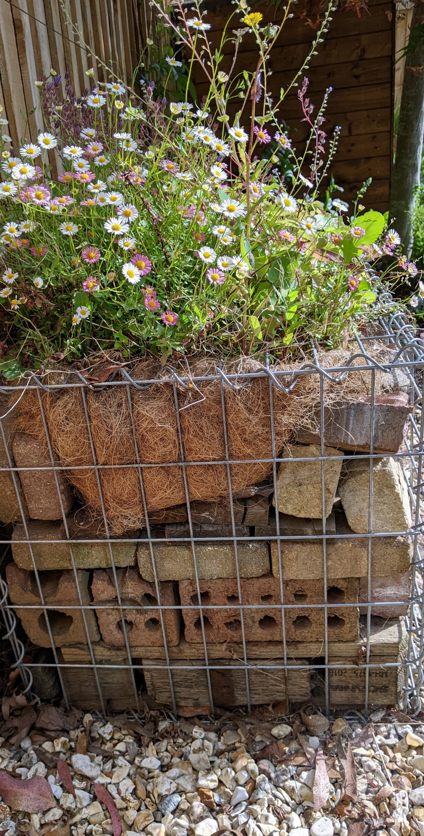
Insects
Insects are an important part of our eco system. An average garden accommodates more than 2,000 different species of insect! Very few of these creatures cause significant harm to our prized plants, and there are many more insects that actually help us to control the ones that do! By providing the right habitats, we can greatly increase the number of ‘beneficial’ insects in the garden.
One way to increase the comfort of your patch for insects is to build them a bug mansion.
For more information about building a bug mansion including materials, instructions, suitable site and what plants are best to plant close by go to:
www.hiwwt.org.uk

